Slide 1

Skills Teaching Using Systematic Instruction
Module 2
Callan Institute
Saint John of God Community Services clg

Slide 2

Layout of the Course
Module 1:
Every moment has potential for learning
Module 2:
Developing and Writing a Skills Teaching Procedure
Module 3:
Implementing skills teaching and planning for the future

Slide 3

Reminder of
First Assignment
Document the decision making process to start skills teaching
Complete the Skills Selection Booklet
Select a target skill
Fill in Section A of Skills Development Booklet (up to the end of Pg. 3)

Slide 4
Developing and Writing A Skills Teaching Procedure

Slide 5

HOW DO WE LEARN?
And why do we learn?

Slide 6
Natural learning diagram
(Example: Answer the phone)
Teacher says
something
and I
try harder!
A cue or a prompt
is given
I respond
If I’m not
Teacher helps me do it right
(I hope so)
Am I correct?
or
either
If I am
Good
things may
happen
Bad
things may
happen
(Wow!)
(Boo!)

Slide 7
The perspective of the person with severe learning or communication difficulties
(Example: Gobble the gook)
Something happens
I’m not sure what I’m supposed to do about it
I wonder what will happen next
?
Something nice happens
Something bad happens
Something
else happens
What was that all about
?

Slide 8
Systematic Instruction
Teacher says
something
(Example: Min the mooche)
Teacher helps me so that I get it right
I respond
(I hope so)
Am I correct?
If I am
If I’m not
Something
good happens
every time
Something
not so
good happens
every time
(Wow!)
(Boo!)
Then we
take a rest...
(and maybe start over again)

Slide 9

The difference
The help given to ensure the correct response is given before the response occurs
Reinforcement is clear, obvious and predictable
A pause at the end of each trial

Slide 10
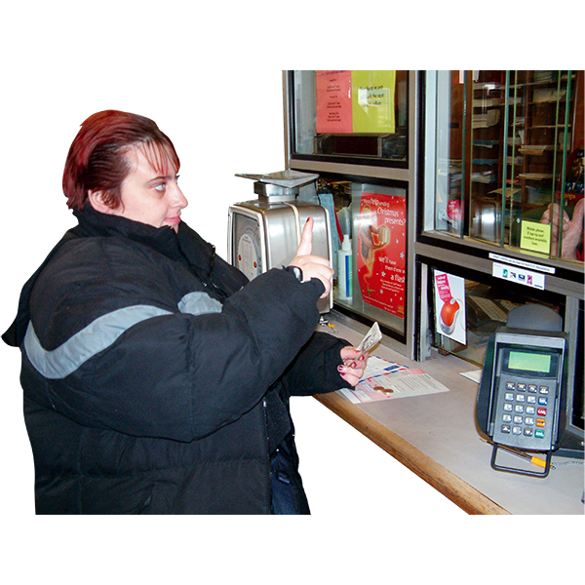
Skills Selection
Are you happy with the skill you have selected?
Is the learner happy with the skill selected?
What life change will it make for them?

Slide 11
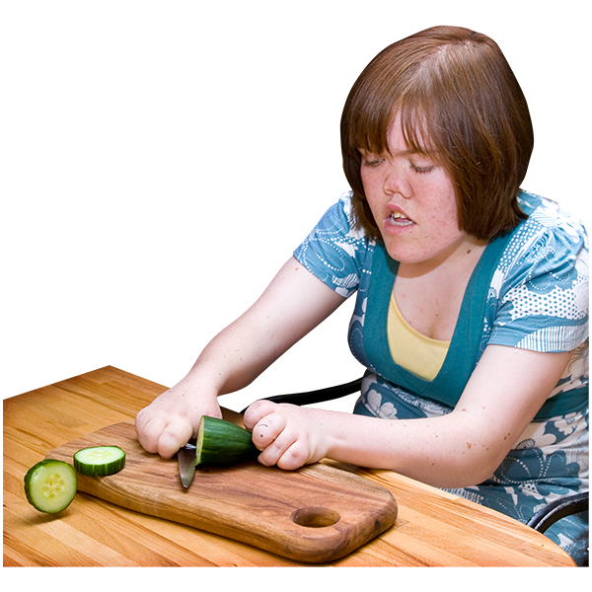
Task Analysis
What are the steps in the task
Is everybody in agreement about this?
Are there more than 6 steps? If so:
  Can we make any shortcuts?
  Do we need to split it into two skills
What would be the best way to teach these steps
  Forward Chaining
  Backward Chaining
  Whole task presentation

Slide 12

Observation & Data Collection
Baseline Data Collection
What assistance does the person need
What type of help does the person respond to best?

Slide 13
Basic Principles of Systematic Instruction
Target
Prompt
Fade
Reward
Record

Slide 14

Target
Who?
Will Do What?
Under What Conditions?
With what supports?
To what criteria?

Slide 15
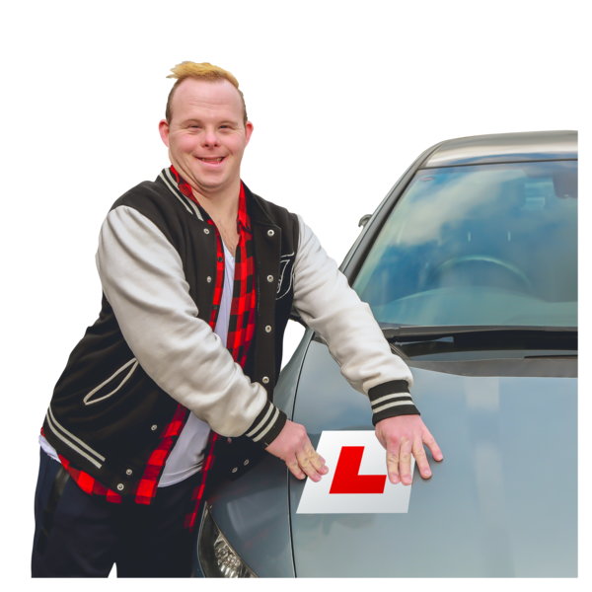
Writing Targets
What is the ULTIMATE target / goal?
Write it from the perspective of the individual – what do they want to achieve at the end of this

Slide 16
Prompting and correcting – What’s the difference?
Learner does not know which is the real cue, and may learn to wait for assistance or correction
Learner may be not be sure what is being reinforced
You cannot fade a correction
Learner experiences failure
Learner learns to respond to the first cue, does not have to wait
Learner is reinforced only for distinctly correct response
Fading is planned: prompt dependence is unlikely
Learner sees that actions have effects

Slide 17

Prompts
Verbal, Physical, Gestural, Modelling (Video), Role Play

Slide 18
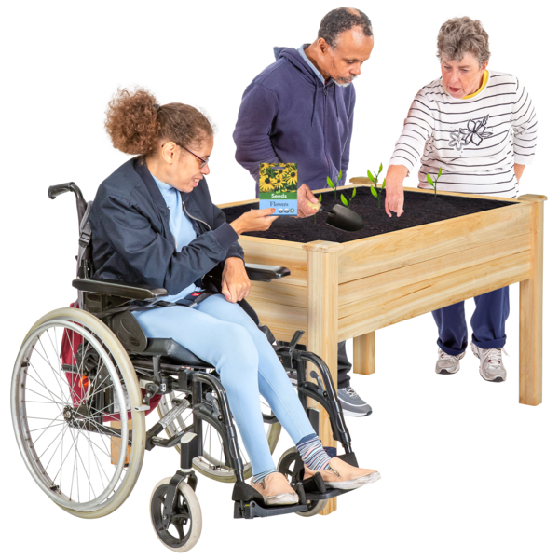
Prompts
Be sure that the prompt gives sufficient help to produce the correct response.
Be sure the prompt is not unnecessary or confusing .
Be sure the prompt can be faded.
Use one prompt type, either physical, verbal or visual.(if more than one prompt used, a prompt fading strategy is needed for each one.)

Slide 19
Why fade prompts?
If a prompt is there, we have to have a plan to gradually remove it
If not, we are simply ‘assisting’ (i.e. active support, with no plan for skills development)

Slide 20
Prompt Fading Options
Verbal prompts(Auditory)
  Fade with time interval(s)
  Audio- IPod, mobile phone head set, church bells
Physical prompts (Touch )
  Hand over hand, elbow, shoulder
  (H/H, H/E, H/S)
Visual prompts(Vision)
  Gestures
  Pictures (picture strips)
  Demonstration
  Proximity

Slide 21
Prompt fading method - example
Mark will sit in his own seat when arrives in the classroom without reminder from his teacher
  Arm around shoulder
  Hand on back
  Hand on elbow
  Walk over together

Slide 22
Fade

Slide 23
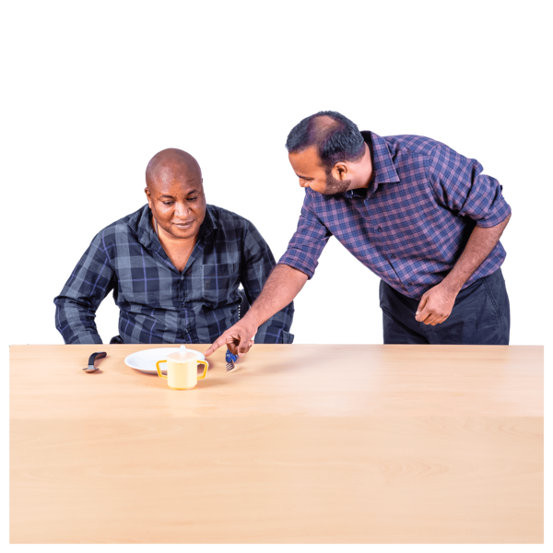
Prompt fading method - examples
Gemma will say “Can I have some help please” without reminder when she cannot get the tape into the tape recorder on five consecutive occasions
David will produce a red card from his pocket, to ask for a task to be removed on five consecutive occasions
Jeff eat sausages, chips and carrots without help on five occasions (Jeff currently only eats semi - solid foods, although he can chew and swallow chocolate and toffee

Slide 24
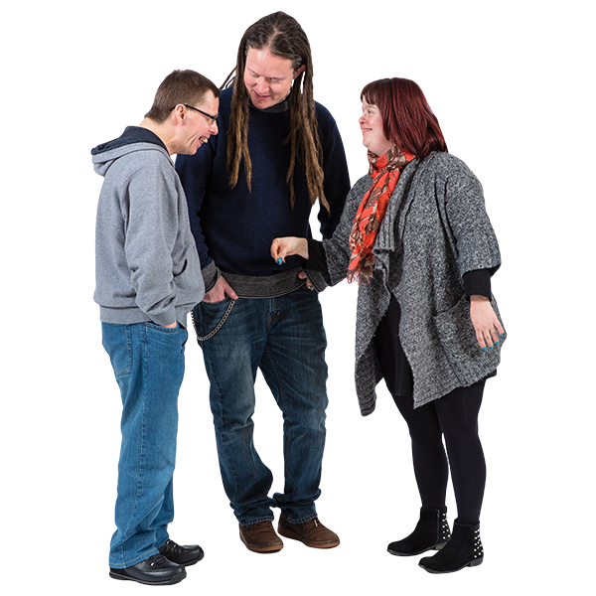
Co-trainer Prompting
Discriminates between initiator and responder.
Easy to fade.
Physical, verbal, visual prompts.

Slide 25
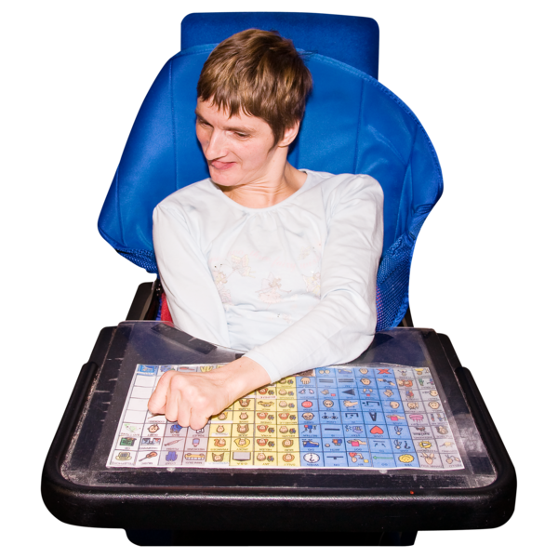
Fading Tips
Select the prompt the responder learns best to
Minimise all other distraction
Fade within that prompt type
Avoid jumping prompt types – this just introduces a new prompt and can be distracting for the learner
Keep the prompts separate to the steps and target (i.e. don’t confuse them!)

Slide 26
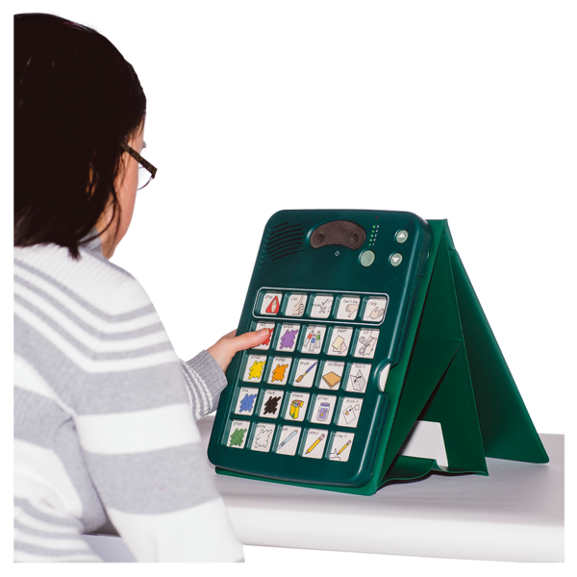
Picture/Object Exchange
Mobility
Self Initiation

Slide 27
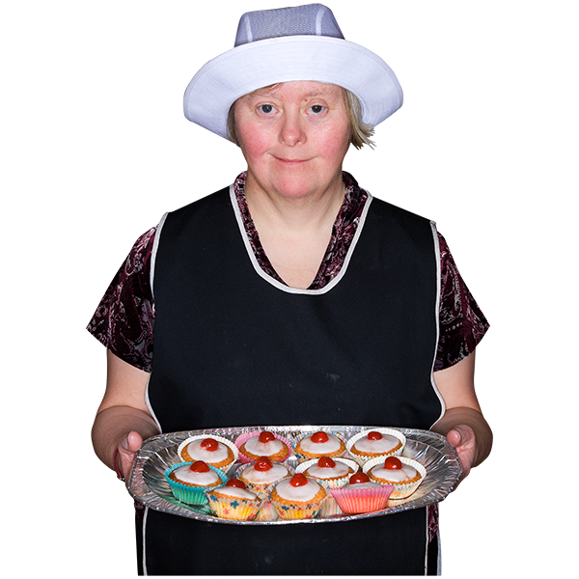
Reward
Learning Is Hard!
It gets easier as we get better at the skill, so we can fade the reward too
Make sure that we’re accessing natural reinforcers instead

Slide 28
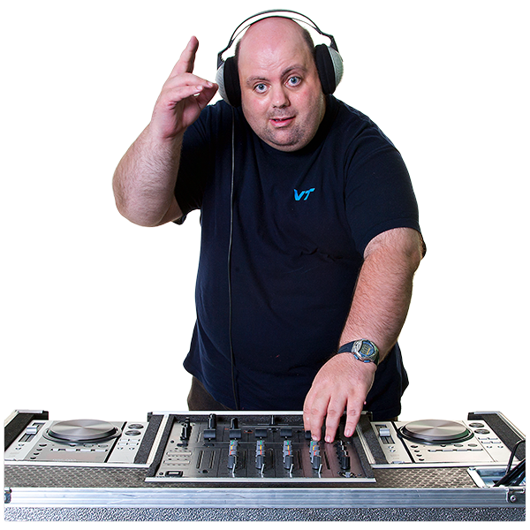
Reward / Reinforcement
Why do we do something again??
Types of Reinforcement
  Primary (deal with primary human drives & necessary for life e.g. food, hunger, comfort, sex)
  Secondary (associated with the above, e.g.. Soft voice, praise, chocolate, pillow, hugs, tea, etc.)
Pairing Reinforcement
  Motivation Analysis
  Creating secondary reinforcers
Contact Natural Reinforcement where possible

Slide 29

Reward
Defined as a performance
Clearly different from the consequence given to a incorrect response
Look for ways that the artificial reward can be faded to the natural environment
Use a natural reward

Slide 30
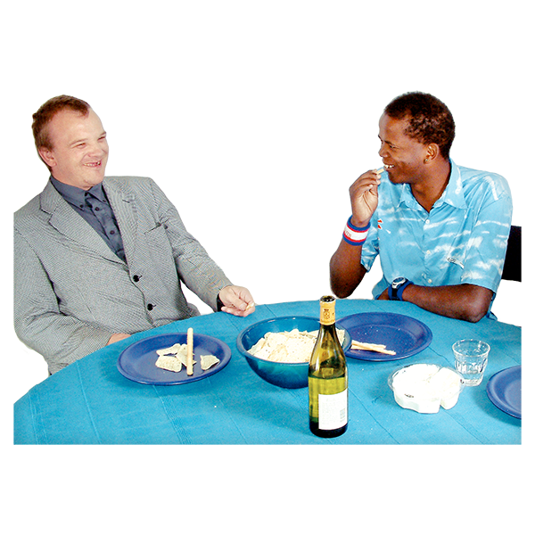
Reward
Artificial Reward
Natural Reward
Fade reward
Examples: Signed Card/ Cup of tea/Road map/A photograph

Slide 31

Motivation Profile
Rationale
  Identify events with sufficient motivational characteristics to outweigh the reinforcement associated with non-performance of the target skill.
  Consent/social validity

Slide 32
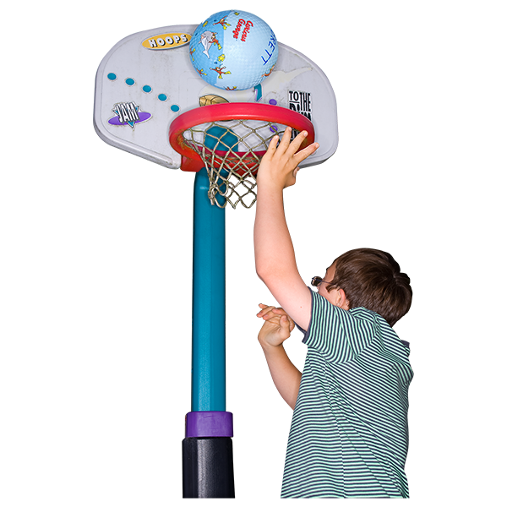
Guidelines for designing token schemes
Individualised
  concept of number
  developmental level
  age appropriateness
  visual / tactile / auditory systems
Ease of administration and mobility
Demonstration of progress
  filling space
  DROP schedules
  jigsaw puzzles
  reward-o-meter

Slide 33

Novelty of delivery enhances reinforcement
  game like quality
  wheel of fortune
  lucky dip box
  lottery ticket
  token tree
  clown
  pick a card
A reward culture
  Review the rules for reinforcement regularly
  Proactive: Review the deal at the beginning of each interval
  Reactive: Review the deal at the first sign of behavioural precursors
  Prompts positive reactions
  Helps establish self-monitoring

Slide 34
Token systems
Tokens can overcome satiation
Consider
  Happy faces with no exchange
  Points for the sake of getting points
  Money that cannot be spent
  John never remembers to take his tokens
  Can of Coke
  Bill loses his tokens every day
  Annie can earn a maximum of 1,024 tokens every day

Slide 35
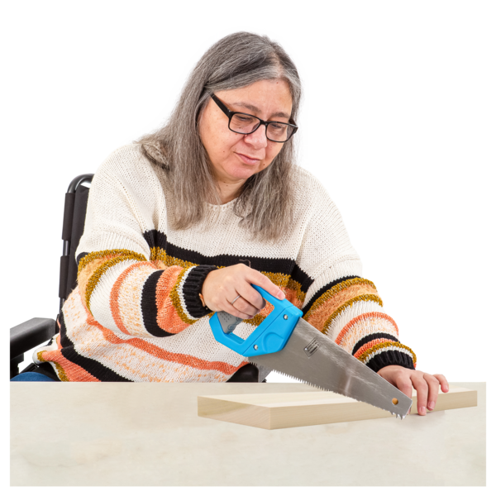
Environmental Adaptations and Cue
Is the person ready to learn right now?
What do you need to have ready to go to ensure a successful skills teaching moment? (time, equipment, materials, etc.)
Are there other distractions in the environment (ambient noise, other people, a busy environment?)
How will the learner know it’s time to practice the skill?
Can we use a natural cue?

Slide 36
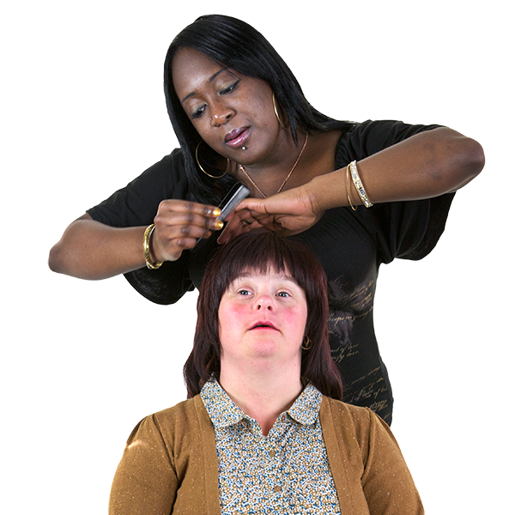
Additional Help
We all have off days
How additional help might the person need if they don’t get it with the prompt level their meant to be at?

Slide 37

Recording
Comments
Date Step Correct / Needed extra help
Programmes on file for months (years!) not reviewed, not active
Progression
criterion reached?
Need to revise
task analysis?
Slow or rapid
progress?
Progression
Revision
Prompts sufficient to
ensure correct response

Slide 38
Codes
1 = Correct response
0 = Opportunity to try again
R= Refused to participate

Slide 39

Second Assignment
Complete the Skills Teaching Development Booklet and Skills Teaching Procedure
Begin to teach skill

Slide 40
Module 3
www.callaninstitute.org
Assignments to: Callan@sjog.ie

